Slide 1
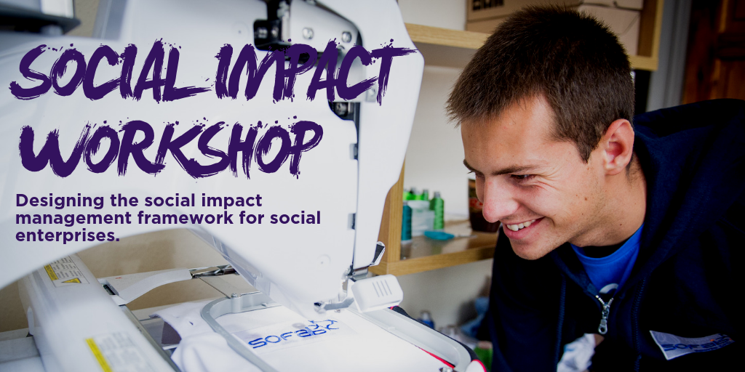

Slide 2
Aim for this session
Quick overview of social impact vs. social value
Understand the necessary steps to set up a Social Impact Management Cycle (SIM-C).
Key concepts
Establish next steps to build up our own approach to impact management.

Slide 3
Session 1: What is social impact?

Slide 4


Social Impact vs. Social Value
Social Impact
Social Value
Social Impact is defined as:
Social Value is defined in the Social Value Act 2012 as:
“The net effect of an activity on the community and the well-being of individuals and families.”
“the additional benefit to the community from a commissioning/procurement process over and above the direct purchasing of goods, services and outcomes.”
or
Centre for Social Impact (CSI)
“A significant positive change that addressed a pressing social challenge.”
or
University of Michigan Business School
“the social change that an organisation creates through its actions (i.e. the impact of its interventions).“
UnLtd
It has to be an actual change that wouldn’t have happened without your work.
It’s about an important change to a person/people/community.
It has to be a change that has some ‘staying power’, it lasts beyond the interaction.

Slide 5
Social Impact vs. Social Value
In a nutshell…
Social & community impacts
http://www.socialvalueuk.org/report-database/
Personal wellbeing impacts
Social impact:
Focused on the change to the beneficiary.
Social value:
a framework to compare the economic and fiscal case of interventions
Household dynamics
Value of economic benefit + social benefits in the community
Economic impacts
Environmental impacts
Political impacts
Health & health systems

Slide 6
Session 2: Social Impact Management system:
Stakeholder Mapping

Slide 7
Social Impact Management Cycle
Comms
(int & ext)
Stakeholder Identification
Value
Proposition
Learning
Problem Definition
Social Impact Management Cycle
Core Business Activities & Strategy (e.g. investment, sales, marketing, training etc.)
Analysis & Insights
Impact Framework
Data Collection
KPIs
Choosing Approaches & Tools
Design
Do
Learn & Share

Slide 8
Mapping key stakeholders
Who Pays
Who Benefits
Who Else Cares
For each group there are different levels of interest and influence. Key questions:
What do you want to tell them?
What do they want to know?
Is it worth your time?
Interest

Slide 9
Exercise: Stakeholder prioritisation
Time: 15 minutes
Stakeholder prioritising: who benefits, who pays, who cares
Get into pairs.
Think about how your stakeholders fall into the 3 categories of who pays/benefits/cares.
Once you have completed your list, pick a maximum of 1 stakeholder per category (e.g. 1 pays, 1 benefits, 1 cares).
For each of the stakeholders answer the following question on the post-it:
  What do you want to tell them?
  Why do they share?
  Why would they care?

Slide 10
Session 3: Social Impact Management system: Problem Statement, Value Proposition & ToC

Slide 11
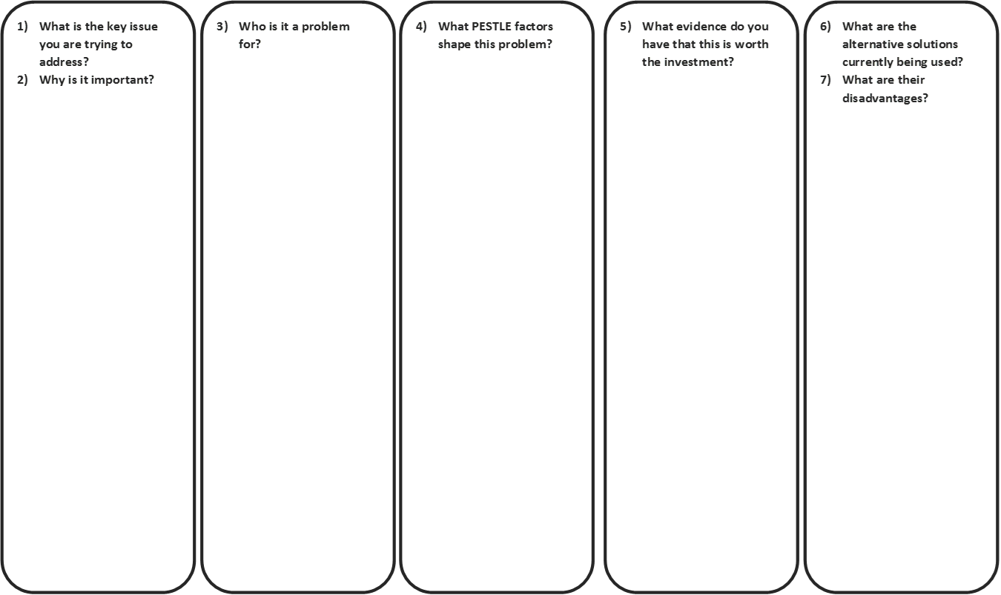
Defining the problem
Use this exercise to define the social problem you are addressing and why it has not been fixed.
Notes:
One of the first steps to really understanding your social impact is understanding the problem you are solving…
This directly feeds into your problem statement that you will often see in a business plan or a pitch to investors.
The tool here shows the ways to break down a problem… it also comes with the recommended problem statement format.
The idea here is to set up the idea of what the real difference your solution will make…
On the left you will see the information on the problem, the customer and how that affects the customer… on the right is what they currently do if they don’t use your services…

Slide 12
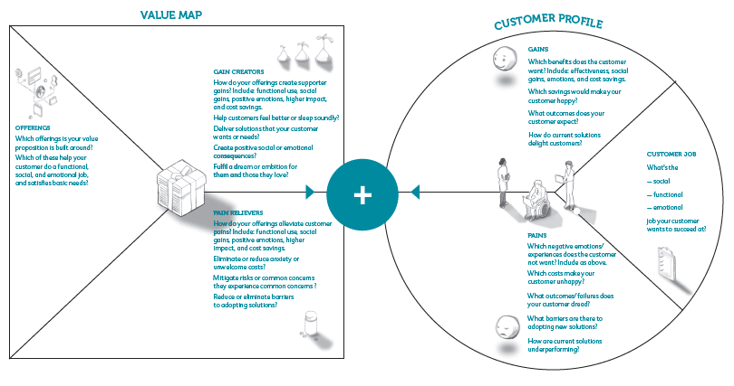
Social Value Proposition
Shows how your social enterprises fixes your customers problem and provides ‘gains’.

Slide 13
Social Value Proposition
Written articulations
Steve Blanks XYZ
Geoff Moore’s VP
Geoff Moore’s VP

Slide 14
Exercise: Develop your problem statement & Value Proposition
Time: 20 minutes
Get into pairs.
Use the problem definition canvas and the proposition worksheet to develop your problem statement and VP.
Basis of Theory of Change

Slide 15
Impact Framework
Assumptions
Assumptions
If people change their behaviour then…
Difference in the user’s life
People will change their behaviours…
If people use the good/service then…
Change in the behaviour of the user
People will use the G&S…
Outputs of activities (goods & services)
If people access…
People will access…
If my enterprise does these…
Activities
I will deliver these…
If my enterprise has these…
Resources
Notes:
What you’ve done here is start building up the components of a results chain… this really starts to test the idea of do I understand how the goods & services I provide lead to a change in the end user’s life?
Is it the change I expect and want?
Thinking from an enterprise perspective… you could look at this…

Slide 16
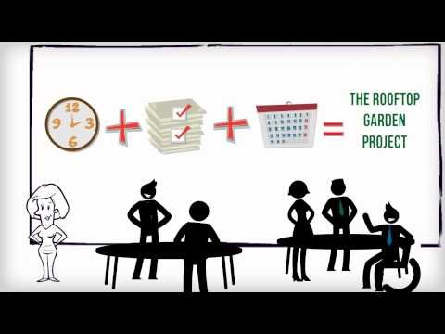
Theory of Change explained

Slide 17
Impact Framework: Activity
With an A1 sheet of paper
4 sets of post it notes.
Sharpie
You can also work directly in your workbook, but we recommend using a pencil as you may move your ideas around.
Goods & services | What behavioural changes? | Who benefits and how? | Change in the world
Up to 5 post it notes. Focus on the goods and services your users access. | Up to 3 post it notes. Focus on the change in behaviour, knowledge or attitude of the user. | Up to 2 post it notes. Focus on the what changes in their social, economic, enviro, physical sphere. | Preferably 1 (up to 2) post it notes. Think about the big picture. What’s the change in the world you want to see?
Notes:
offer to provide feedback to those that send them to

Slide 18
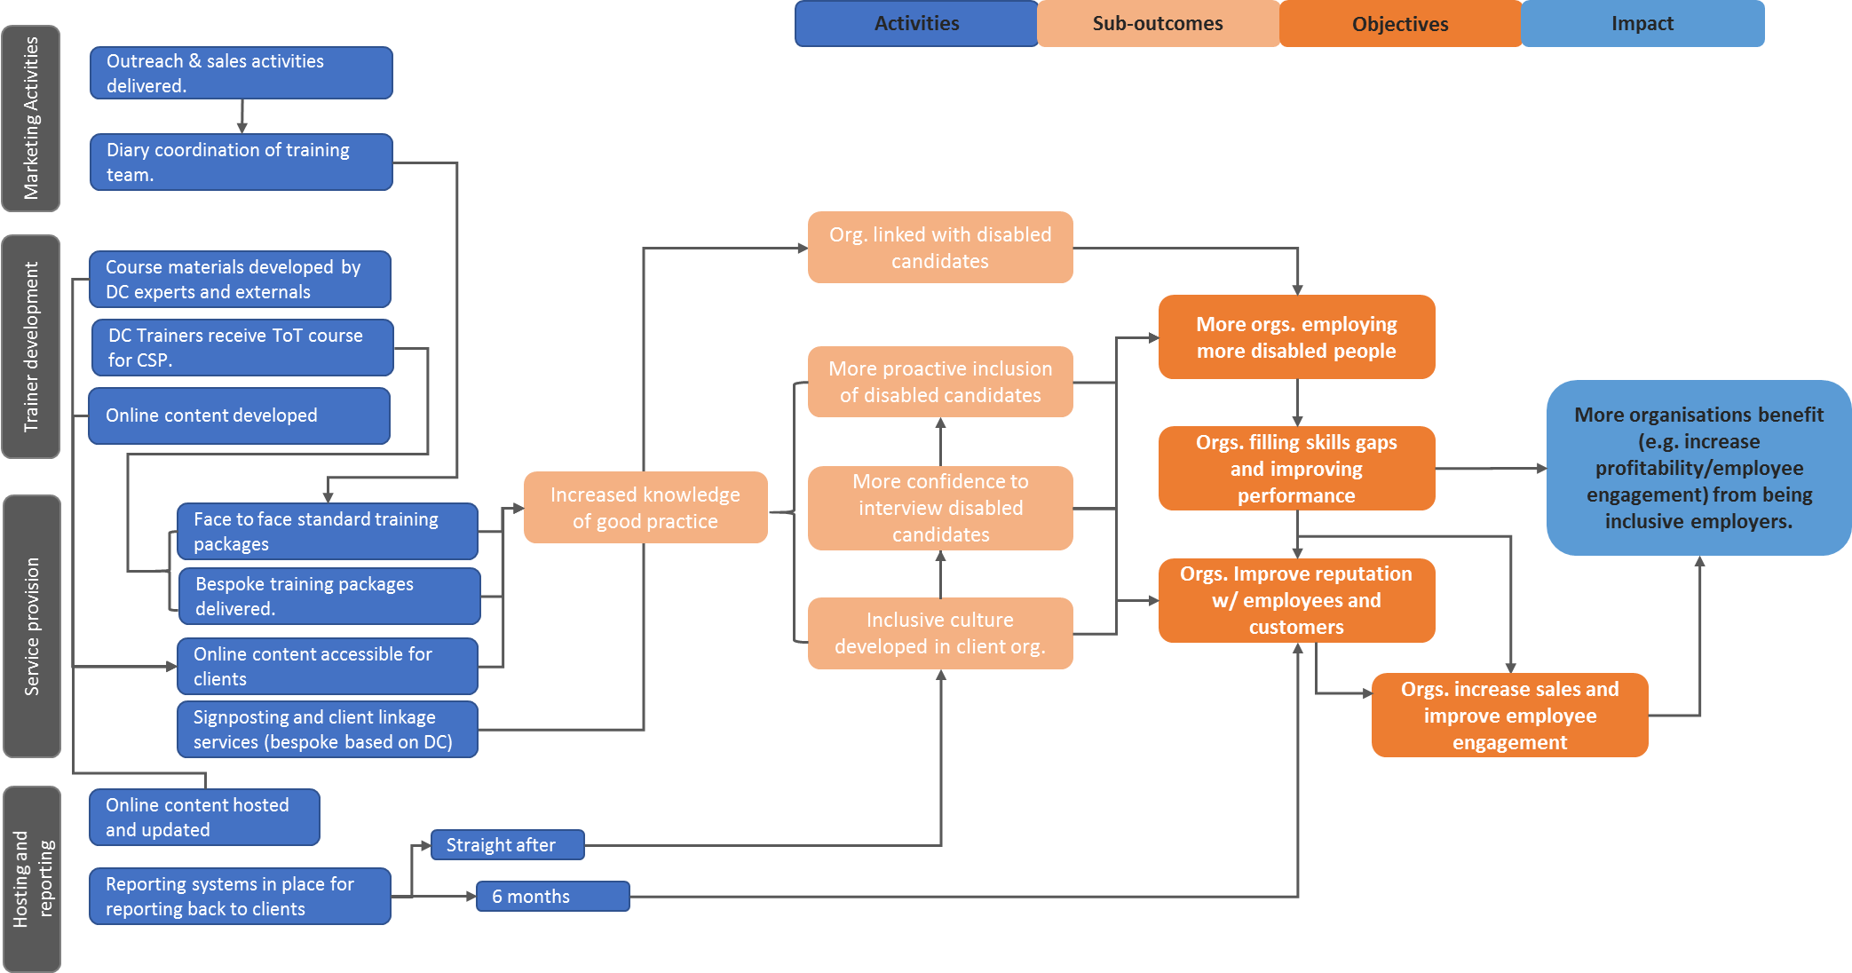
An example: Disability Challengers ToC

Slide 19
Rationale: People with physical and learning disabilities face barriers to inclusion and effective participation in society, especially in the field of sport and physical activity. They face a number of number of physical, practical, social, cultural and emotional barriers (e.g. lack of time, finance, stigma). As a result they have a higher risk of developing an unhealthy lifestyle.
EXAMPLE ToC
Goal: to empower people with learning and physical disabilities or people from disadvantaged backgrounds to participate in mixed ability sport alongside able-bodied people through education and sporting means.
Inputs
Human
No of staff working on the programme
No of volunteers participating in programme
Financial resources
Projected expenditure vs. actual expenditure
Material resources
Value of non-financial resources secured (e.g. event space)
Activities
Train coaches and volunteers
Mixed-ability sport & physical activity
Create local, nationals and international support network to share best practice
Produce new resources and learning modules
Education & awareness raising
Work experience / placements
Outputs
No of people trained in mixed-ability model
The range of mixed ability sports offered in each country
No of people with participating in mixed-ability sports
A growing mixed-ability community
No of publications produced (including resources, guidelines, protocols)
No of awareness raising events
No of work experience placements completed
Short-term Outcomes
Participants with disabilities
Increased accessibility & access to opportunities
All Participants
Increased sense of teamwork, respect, enjoyment, self-discipline & fair-play
Increased self-esteem, confidence & resilience
Increased knowledge, skills & expertise
Increased physical activity
Wider Community
Increased awareness about mixed-ability sport and the rights and opportunities for people with disabilities
Increased interaction between people with different abilities, backgrounds & nationalities
Longer-term Outcomes
Participants with disabilities
Breaking down physical & emotional barriers to participation
All Participants
Increased resilience, self-esteem & self-confidence
Increased integration
Healthier lifestyles
Wider Community
Changing attitudes and perceptions about people with disabilities
More people actively support and promote social inclusion
Increased collaboration between network members & others
Impact
A cultural shift: attitudes and behaviours that foster equality, social inclusion & wellbeing.
Assumptions
Partners are able to recruit and retain the right staff and volunteers to ensure that they can fulfil their roles and responsibilities
Assumptions
All partners document and share of good practice
Enough demand and interest in mixed-ability sports
Assumptions
Long term engagement with key stakeholders
Support from national sport bodies
Notes:
Why using example? You’re not invested; can be objective, can see what goes where
Things to bring up:
Made up!
Not perfect.
Any themes in the outcomes? Can the outputs be attached to the same theme?
Outcomes to goal
Are all the outcomes actually linking to the goal? Can we be sure that home cooking or gardening increases veg consumption? Or attitude changes? Is an increase in adults and children cooking together or gardening a positive outcome that isn’t necessarily leading to the goal?
2. Short term goals to long term goals
Can we know that the short term goals lead to longer-term goals? Will enjoying the garden experiences actually lead to eating more veg, or doing more gardening?
3. Activities
Are all of the activities aiming to address the goal directly? How much are they just ‘what they do’?
Some activities can’t be
4. Which of these could be measured?
Activities: website hits / booklet downloads, course attendance, how much soup gets eaten (but we can’t follow up on individuals).
Let’s look just at the output ‘local children eat soup’. Can we be sure that they’re actually increasing their veg consumption? Could it be the same 3 children every day, and if so how do we know impact?
‘They see posters around’ can’t be measured, that’s touching many, many more people than we can measure and test
Which of the long-term outcomes can be measured? I’d say improved attitudes could be on a feedback form. Children learning about veg almost requires a test!
5. Outputs to outcomes
5. Who are the participants?
Children and adults
Seems like some of the activities are geared towards children, some towards adult. Maybe needs to distinguish which activities and outputs and outcomes are for whom, seeing as some of the outcomes are for changing adults, thus changing children, some directly addressing children
Children/adults who go to training courses may be far more likely to have improved attitudes to veg than those who eat the soup once at school (then again we know that their veg intake has gone up for that day! Is that enough to say we’re reaching our goal?) and adults who see a poster are unlikely to do more home coming with their child due to just that intervention
So we’ve got different levels of participants, who might hit different outcomes, and different information can be gathered from them
7. Other assumptions
Targeting adults will vicariously affect children
If veg consumption increases, nutrition improves (eating less unhealthy food? Or just more food overall?)

Slide 20

There are many ways to present a theory of change
Impact
Outcomes
What we influence:
The opportunity for skills development for young people in the prison service.
The chance to benefit from working with a commercial organisation and in a team.
A new way for prison officers and staff to engage with young people.
More businesses in the coffee industry consider employing ex-offenders.
What we do:
We provide training and employment opportunities to young prisoners and ex-offenders.
G&Ss
What we want to achieve:
Young redemption graduates enter gainful employment.
Reduced rates of reoffending for redemption graduates.
Improved well-being and conditions in prison.

Slide 21
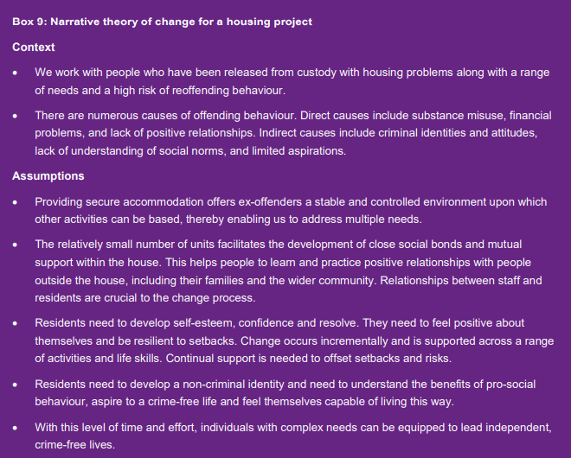
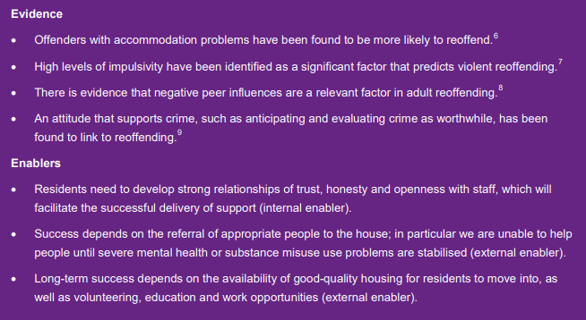
TOC example: A written TOC

Slide 22
A diverse market place with social entrepreneurs at its core is the best way to meet the varied challenges of later life
Investing in social entrepreneurs in the sector will deliver meaningful change in
the long term
We find, fund, and support social entrepreneurs to reach their potential, including
And act to breakdown barriers social entrepreneurs face to maximise their impact.
We work with innovators to transform the system, leading to:
And society joins in taking social entrepreneurs mainstream.
Our S4AS theory of change
Goal – UK is the best place to grow old
Our Core Beliefs
The sector works best and will have most impact when it recognises social value alongside medical and economic factors
People and communities are best placed to design and choose the services which meet their needs
SEs have increased knowledge, skills, and confidence
SEs develop more relevant products and services, products, and interventions for people in later life
Increased demand for products & services provided by SEs
Social Entrepreneurs are valued and understood for the change they create
Our Assumptions
We can reach and support a diverse range of people from different backgrounds.
People trust the products, services, and interventions offered by social entrepreneurs.
Social ventures that can measure and evidence their impact to appropriate audiences are better able to raise investment and secure contracts.
Investors are less risk-averse when social entrepreneurs are supported by UnLtd
Social entrepreneurs can function in different political systems and adapt to shifts in the sector
Stakeholders understand and buy-in to the value of social entrepreneurs and social entrepreneurship as an economic model
Turnover of staff with key partners doesn’t hamper our work
SEs have better understanding of the needs of people in later life
More people believe that SEs offer legitimate and effective solutions for people in later life
People in later life are seen as an asset - people in later life shape products, services, and interventions
Social ventures have increased operational capacity
SEs are better able to evidence the impact of their venture to different audiences
More SEs are connected to relevant and wider networks
More evidence and learning about the quality, cost-effectiveness and impact of products and services is available
SEs are better able to secure sustainable routes to markets with consumers and commissioners
Social Ventures are better able to evidence and grow their social impact
SEs are more able to secure appropriate capital (quantity, timing, risk)
Increased wellbeing and health outcomes for people in later life
A better connected ecosystem of SEs is creating solutions for and with people in later life
Policy and legal context better supports and incentivises social entrepreneurship
Closer relationships with key actors in the ageing sector to make it easier for SEs to operate effectively
Notes:
A way of showing a lot of information and again… showing the pathway from what we do through to the impact we want to achieve.

Slide 23






We work with people who are long term unemployed and face barriers to employment
We provide jobs and tailored support employees to overcome their barriers to employment and to succeed in their job with radiant cleaners. We lead by example in providing professional cleaning services while being an excellent employer to those most at risk from exclusion from the jobs market.
Better lives for our employees
Job security and
Good income
Homeless
Foster care leavers
Substance abuse
Demonstrate the
value of ethical
business practices
Mental health challenges
Personal Support
Supportive jobs
Our Impact:
Radiant cleaners will support people in Nottingham and the UK in poverty suffering from long term unemployment to achieve a better standard of living through good employment at Radiant Cleaners and by changing the industry practice around employee support.

Slide 24
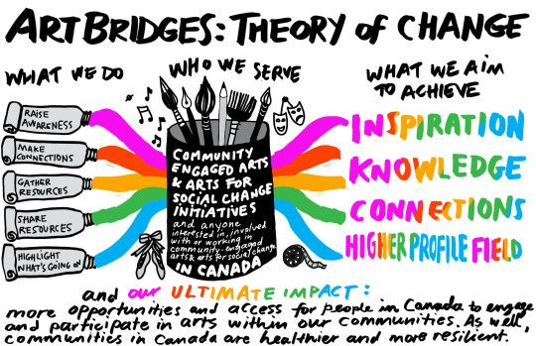
Notes:
They can be beautiful

Slide 25
Community Souls
Mission: We provide employment and create space to enable people to self-direct their own work, learning and thinking.
CSCC employees and ex-employees are in jobs providing good quality of life for the (ex-)employees and their families
CSCC employees benefit from LLW and supported employment model and contribute to UK economy (fiscal value/economic value)
Improvement in wellbeing and self-efficacy (e.g. capacity to make own and deliver on own decisions improves).
CSCC employees complete trainings and achieve PDP aims to improve employment prospects
CSCC employees access additional support from 3rd party providers to improve resilience.
Employment
Mentoring
Training
Wrap around support
London living wage
Flexible hours
1 year contract
Paid mentoring sessions designing personal goals
Flexible mentoring times
Funding of relevant training for CSCC and future jobs
Support in identifying relevant training
Direct linkage to statutory services for employee support
Embedded in local community/charities for support
Mentoring, training and wrap around services to provide supported employment.
Problem: People in low/no income households in deprived areas often lack the necessary opportunities and support to thrive in good jobs. This often occurs for people with barriers to work such as single parents, ex-offenders, NEET and many others with complex barriers to work. This leads to a sense of non-agency and a lack of confidence to pursue opportunities to thrive in employment and live a good life.

Slide 26
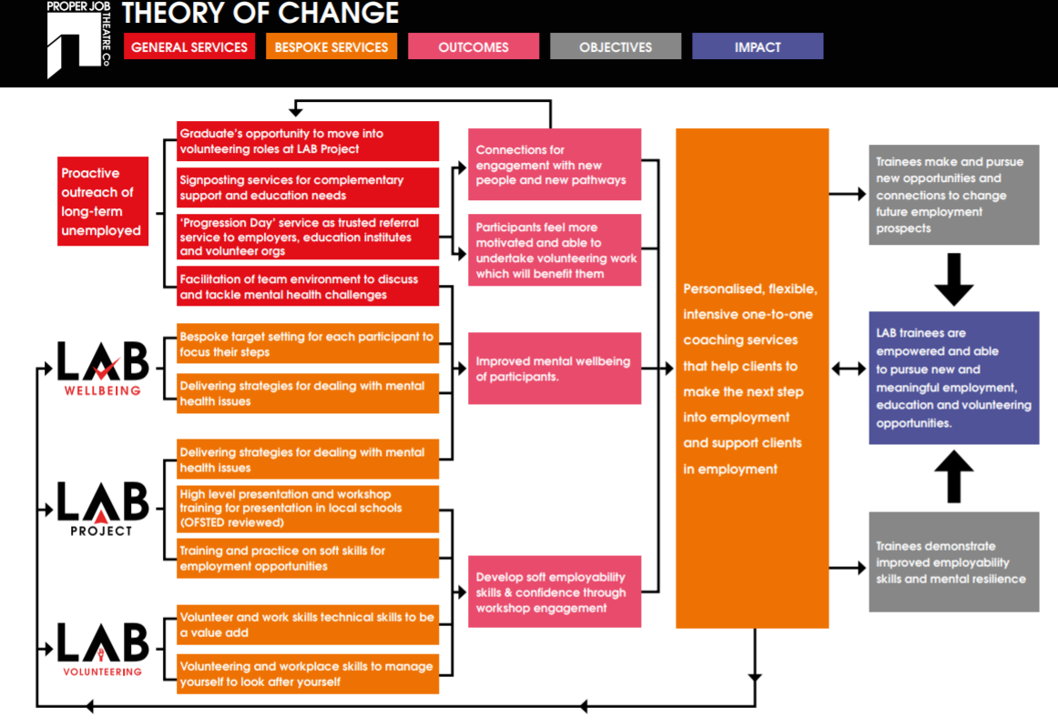

Slide 27
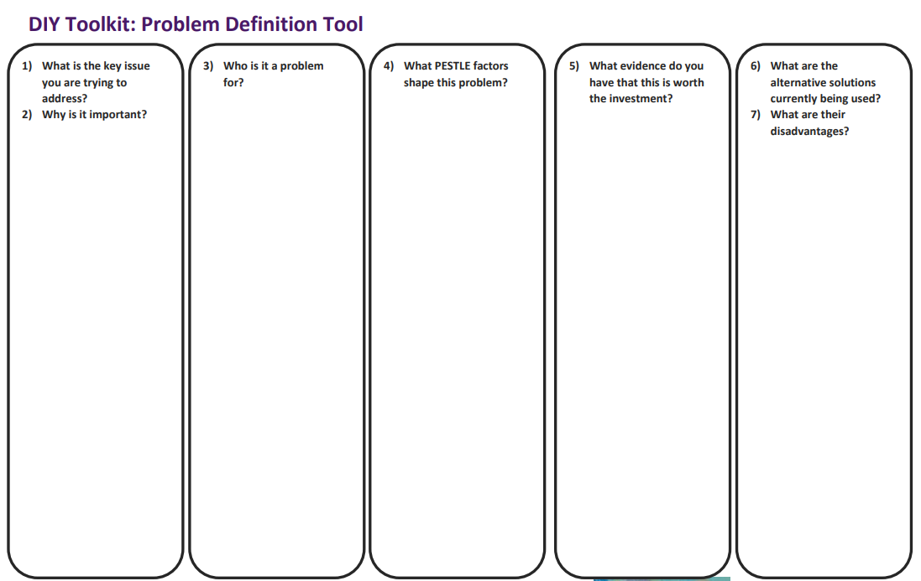
Review alignment: Do all 3 work together?
Problem defined
Clarity on how your solution solves the problem
Value proposition defined
Impact Framework
Notes:
Remember to keep this in as its about pushing the ‘audience’ understanding on the problem you’re solving and the way you do (e.g. framing it outwith the lawyer frame of reference and mind set)
It’s about seeing the world through the lens of the final beneficiary.

Slide 28
Social Impact Management
Comms
(int & ext)
Stakeholder Identification
The ‘Design’ stage sets up the what you will measure.
The ‘Do’ is the actions you will take to measure the impact you achieve.
To ‘Learn & Adapt’ is the hardest but most important part of SIM-C. It relies on your leadership, organisational culture and ability to adapt your ways of working.
Start here
Learning
Problem Definition
Social Impact Management Cycle (SIM-C)
Core Business Activities & Strategy (e.g. investment, sales, marketing, training etc.)
Analysis & Insights
Impact Framework
Data Collection
KPIs
Choosing Approaches & Tools
Design
Do
Learn & Adapt
Additional - https://www.goodfinance.org.uk/measuring-social-impact/social-impact-guidance
Notes:
Social Impact Management (SIM) is essentially the way in which you understand, measure and then leverage your social impact. The Social Impact Management Cycle (SIM-C) must be proportional to the size of your enterprise.
The Social Impact Management Cycle (SIM-C) is an illustration of the 3 stages of impact management which should be set clearly for social impact management to contribute to your work. The key tools for each stage will be explained in the upcoming ‘How’ section.
As we break down our approach to Social Impact Management (SIM), we will show you how your SIM will compliment your core business activities.
But here are the key takeaways:
Proportional: This cycle can be scaled to managing a huge project costing millions… all the way down to testing a single idea… the steps in the cycle just need to operate at different scales.
Integrating: This work can’t run as a separate add on to your already busy lives… we’ve pulled it out here but this needs to integrate with your core business activities .
Have a reason: don’t ever start measuring impact until you know why you are doing it and what you will do with that data…

Slide 29
Session 3: Key concepts for measuring impact

Slide 30
3 key concepts to keep in mind
Deadweight
Attribution
Benefit Period
Is what would have happened anyway without your intervention.
This can be slower growth, stagnation or decline.
Is a review of who else or what else may have generated a benefit (or pain) for your target beneficiary.
Is how long the benefit of your intervention lasts for the beneficiary.
Different interventions have different benefit periods.

Slide 31


Demonstrating your social impact: Deadweight
Your social impact is the change that wouldn’t have happened without your intervention.
1 acre
1 acre
2 acre
1 acre regeneration
Notes:
One of the key things about demonstrating your social impact is to show what would have happened if you were not there… if that service had not been provided…
Let’s take a really simple example… say there are 2 acres of land… 1 is well forested and 1 is barren because of a tree blight which wiped out the forest unexpectedly…
You’re enviro charity comes along and invests in regenerating that forest… There are now 2 acres of forest instead of 1.
What is your impact?

Slide 32



Demonstrating your social impact: Attribution & Benefit Period
Support
Network
Your Enterprise
Family
How much of this achievement is because of your work?
Youth Journey to Employment
Your Enterprise
Family
Family
School
College
Family
School
Sports team
Sports team
Notes:
This can get a bit more complicated… particularly when we have social issues…
Let’s say we have our young man Peter who is just finishing school. It has been hard for Peter so you’re social enterprise provides support to get him on the path to a good job.
But you’re not the only one working with Peter… he has family, he plays in a football team, the school provide services.
But let’s say you do excellent work with Peter. You provide training and mentoring and he moves away to a great college… he is on the way to becoming the employed equivalent of the hindu goddess Parvati…
If your social mission is to help get Peter into employment… then that is achieved… but how much of that was your support? Would he have made it anyway?
This becomes an important question in social value in particular…
But fortunately… we have the tools here today to help breakdown the steps you can take to show how your actions… lead to the impact that you say they will…

Slide 33
3 key concepts to keep in mind
Deadweight
Attribution
Benefit Period
Is what would have happened anyway without your intervention.
This can be slower growth, stagnation or decline.
Is a review of who else or what else may have generated a benefit (or pain) for your target beneficiary.
Is how long the benefit of your intervention lasts for the beneficiary.
Different interventions have different benefit periods.

Slide 34
Session 4: Establishing the key indicators

Slide 35
Key data sources and indexes
Nomis- for labour market and socio-economic data.
IMD (Index of multiple deprivation) – for postcode based indexes of deprivation.
Labour market survey (A01 and A08 (disability) – For up to date data on employment rates.
Impetus youth employment gap (upcoming) – for youth employment performance across UK
Thriving Places Index – For a holistic view of local authority performance.
ONS wellbeing – For national performance of wellbeing in UK.

Slide 36
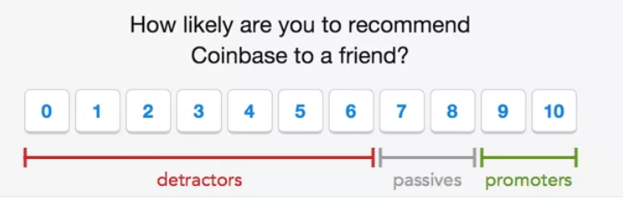

Key data sources and indexes
Net Promoter Score (use Survey Monkey):
XYZ
SWEMWBS wellbeing – 7 questions on wellbeing that can be used for SCBA.
ONS wellbeing – 4 questions on wellbeing to compare to national average.
General self-efficacy – general questionnaire for independence

Slide 37
Types of KPIs
Quantitative
Qualitative
Quantities and amounts
Judgement, perception, emotion etc.
Cross reference
No. of customers reporting increased income as a result of our training.
Evidence that beneficiaries wellbeing has increased as a result of our support

Slide 38



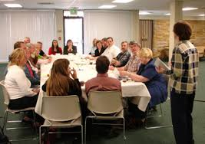
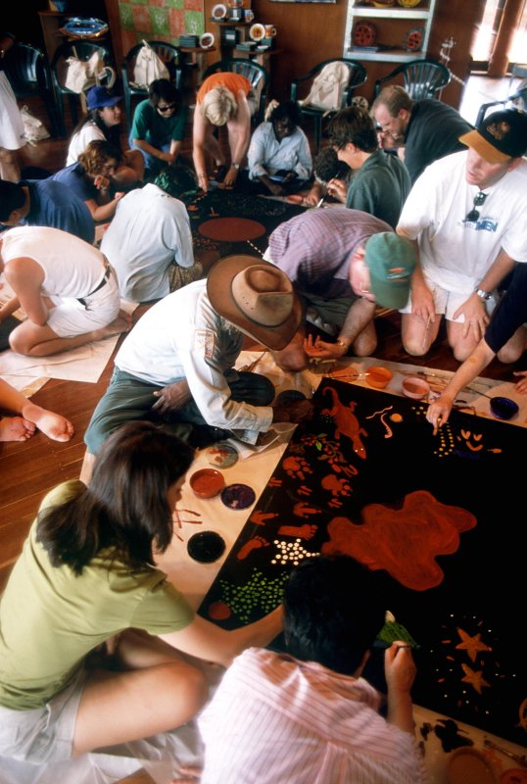



Choosing Approaches and Tools
Pre-existing tools, data and methodologies (e.g. Lean Data Acumen, Most Significant Change, Wellbeing Index)
Forms, surveys
Focus groups
Secondary information
Interviews
Bespoke self-developed tools and methodologies
Diaries
Beneficiary photography
Social media
Art and creative approaches

Slide 39
Data Collection & Analysis- It’s all about planning
Be proportional.
Have a reason for data collection and have an ‘end goal’.
The UnLtd Data Collection Planning Tool gives a step by step exercise of how to plan your data collection activities and to think about your analysis.

Slide 40
Exercise: KPI setting for your Theory of Change
Time: 15 minutes
Impact Framework development
Get into pairs.
Using your Theory of Change and thinking about the assumption you want to test. Decide on:
  1 KPIs for your outputs
  1 KPIs for your outcomes
  1 KPI for your overall impact
Will your KPIs tell you if you have solved the problem for your customers/beneficiaries as you defined it?

Slide 41
Recommended follow up
Based on your work book, work with your VM to refine and build up your Theory of Change.
Put in place the KPIs you’d like to collect.
Identify whether you will use any external data to validate results.
Target: Share a soft copy of this with your Venture Manger by end of August.

Slide 42
Thank you.
For any questions contact joshmeek@unltd.org.uk and jamidixon@unltd.org.uk

